Slide 1

LAB 3 - SIMPLE CALCULATOR
To create a simple calculator app with Android Studio.

Slide 2
LAB INSTRUCTIONS
If you have completed, wait on your seats. I will come and check the task.
All those you have not completed the task, try to complete in the lab.
If someone is unable to complete, the task will be checked in the next lab(but the person would be judged on current lab progress as well).
Layout of the app should be proper and all the functions should work.
Submit the task on Brightspace.

Slide 3
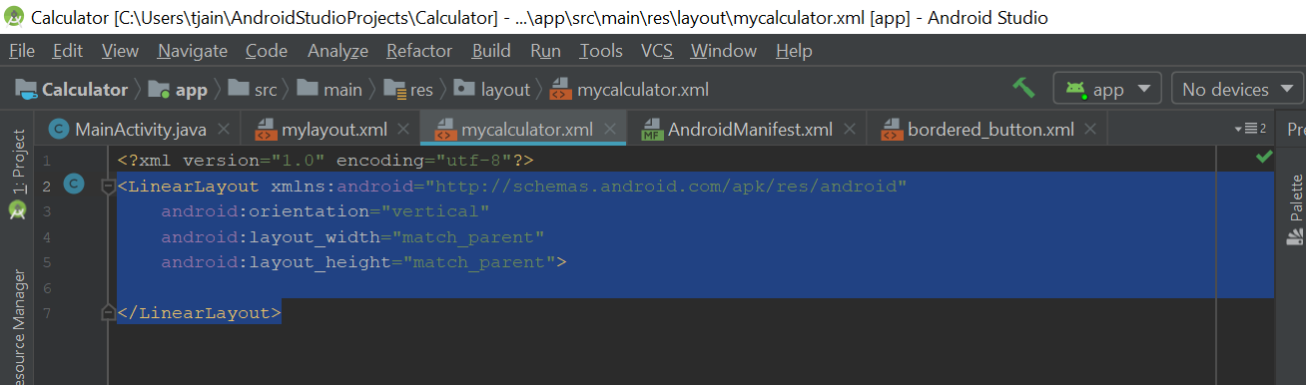
Tips TO CREATE good layout
Delete the existing (xml)layout file from app/resources/layout/FileName.xml
Right click on the layout folder.
Select New → Layout Resource File.
Enter the file name as mycalculatorlayout.xml and select the root element as LinearLayout.
Open mycalculatorlayout.xml file. It should contain a tag as given in the image.

Slide 4
Cont…
Add a TextView Tag inside the LinearLayout tag (Nesting of tags)
<TextView android:id="@+id/CalculatorScreen" android:layout_width="match_parent" android:layout_height=“150dp" android:gravity="center|right" android:textSize="30sp" />
7. Below the TextView tag add another LinearLayout tag which will contain four buttons tag as shown in the image.

Slide 5
<LinearLayout android:layout_width="match_parent" android:layout_height="0dp" android:layout_weight="1" android:orientation="horizontal" > <Button android:id="@+id/n7" android:layout_width="0dp" android:layout_height="match_parent" android:layout_weight="1" android:text="7" android:textSize="25sp"/> <Button android:id="@+id/n8" android:layout_width="0dp" android:layout_height="match_parent" android:layout_weight="1" android:text="8" android:textSize="25sp"/>
<Button android:id="@+id/n9" android:layout_width="0dp" android:layout_height="match_parent" android:layout_weight="1" android:text="9" android:textSize="25sp“ /> <Button android:id="@+id/division" android:layout_width="0dp" android:layout_height="match_parent" android:layout_weight="1" android:text="/" android:textSize="25sp“ /> </LinearLayout>

Slide 6
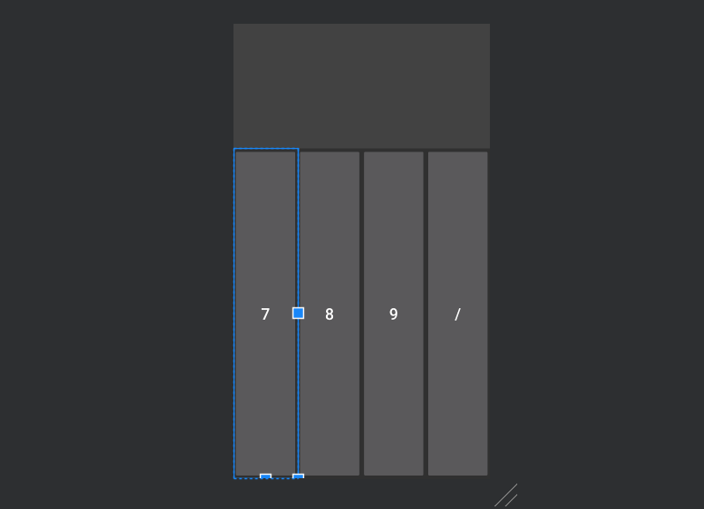
LAYOUT AFTER STEP 7

Slide 7
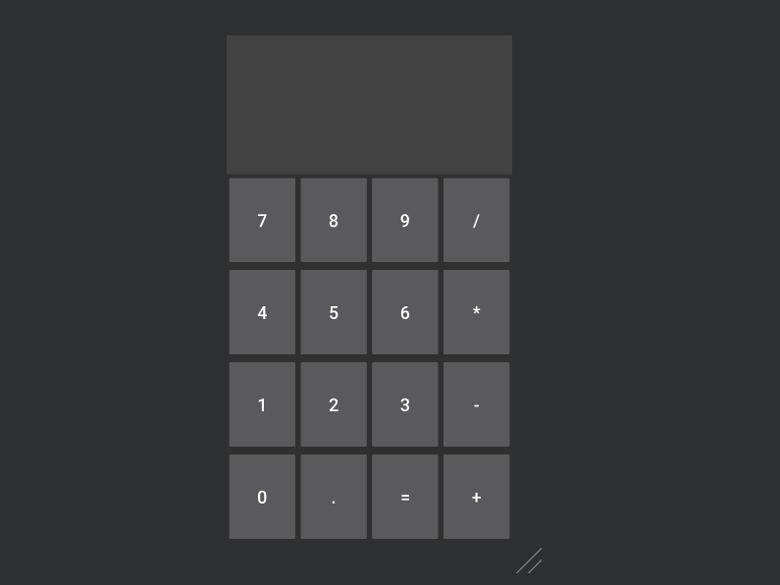
CONT…
Copy the code in step 7.
Below the code of step 7 paste the code you copied.
Change the Button ids and text of the Buttons. android:id android:text
Repeat from step 7 to obtain the layout as shown in the image.

Slide 8
Cont…
12. For clear everything(CE) button repeat the similar steps but add only one button in the LinearLayout.
<LinearLayout android:layout_width="match_parent" android:layout_height="0dp" android:layout_weight="1" android:orientation="horizontal" > <Button android:id="@+id/clearEverything1" android:layout_width="0dp" android:layout_height="match_parent" android:layout_weight="1" android:text="CE" android:textSize="25sp" /> </LinearLayout>

Slide 9
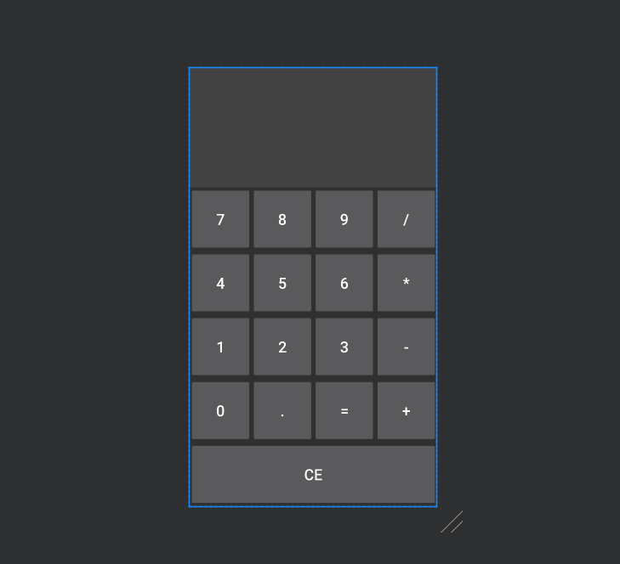
Final layout

